Slide 1
Number Day 2020
Seeing maths all around us and
Using every day

Slide 2
So Why Is Maths So Important?
Numbers, measurements, shapes and calculations are a part of everyday living.
It is a way of interpreting the world around us.
Without a good understanding of maths happening around us, one can encounter significant problems in life.

Slide 3
Helping Your Child
Knowing how your child is taught.
The Newlyn School website hosts a copy of the procedures and steps that your child is taught the different aspects of maths. This is called ‘the calculation policy’.
Go to Home page – click on ‘School Life’ tab
– click on ‘Our Curriculum’ tab down the side
- click on Mathematics to find the calculation policies for Key Stage 1, Lower and Upper Key Stage 2.

Slide 4
Helping Your Child
Learn the bonds of 10 – then 20 together.
And all the numbers in between.
Learn all the bonds to 100.
Practise learning times tables with your child.

Slide 5
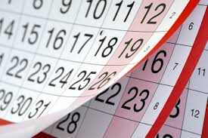
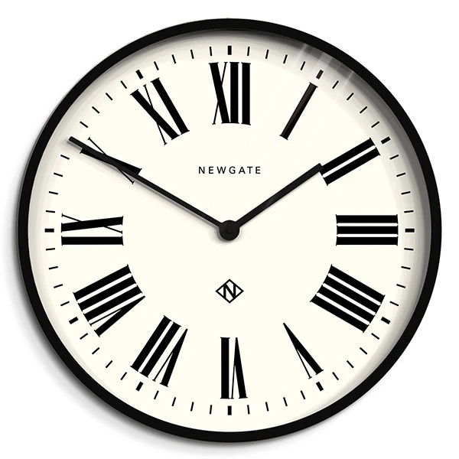
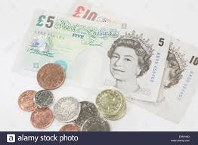
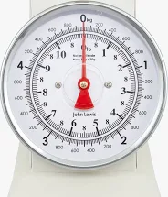
Helping Your Child
Talking about practical everyday maths as it occurs.
In the supermarket
Around the home
When cooking or baking
In the garden
Driving to school or on any journey

Slide 6
Question stems

Slide 7
Websites that may find useful:
www.nationalnumeracy.org.uk then search for family maths toolkit in their search bar.
www.keystagefun.co.uk – Squeebles Maths Race
https://komodomath.com – you register and there is a cost but you can do a free trial (designed by teachers for families).

Slide 8
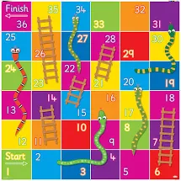
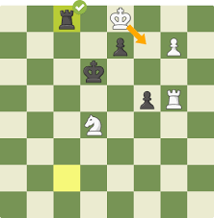
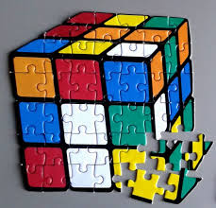
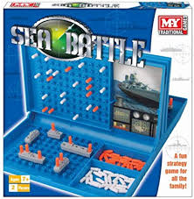
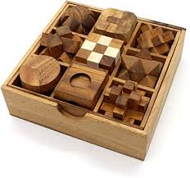
Games and Puzzles:

